Slide 1
SIC030 - PPT - SESI ke 11 Sistem Perdagangan Elektronik
E-Commerce Security
M HANIF JUSUF ST MKOM

Slide 2
Learning Objectives
Document the rapid rise in computer and network security attacks.
Describe the common security practices of businesses of all sizes.
Understand the basic elements of EC security.
Explain the basic types of network security attacks.

Slide 3
Learning Objectives (cont.)
Describe common mistakes that organizations make in managing security.
Discuss some of the major technologies for securing EC communications.
Detail some of the major technologies for securing EC networks components.

Slide 4
Brute Force Credit Card Attack Story
The Problem
Spitfire Novelties usually generates between 5 and 30 transactions per day
On September 12, 2002 in a “brute force” credit card attack, Spitfire’s credit card transaction processor processed 140,000 fake credit card charges worth $5.07 each (62,000 were approved)

Slide 5
Brute Force Credit Card Attack (cont.)
The total value of the approved charges was around $300,000
Spitfire found out about the transactions only when they were called by one of the credit card owners who had been checking his statement online and had noticed the $5.07 charge

Slide 6
Brute Force Credit Card Attack (cont.)
Brute force credit card attacks require minimal skill
Hackers run thousands of small charges through merchant accounts, picking numbers at random
When the perpetrator finds a valid credit card number it can then be sold on the black market
Some modern-day black markets are actually member-only Web sites like carderplanet.com, shadowcrew.com, and counterfeitlibrary.com

Slide 7
Brute Force Credit Card Attack (cont.)
Relies on a perpetrator’s ability to pose as a merchant requesting authorization for a credit card purchase requiring
A merchant ID
A password
Both

Slide 8
Brute Force Credit Card Attack (cont.)
Online Data’s credit card processing services, all a perpetrator needed was a merchant’s password in order to request authorization
Online Data is a reseller of VeriSign Inc. credit card gateway services
VeriSign blamed Online Data for the incident
Online Data blamed Spitfire for not changing their initial starter password

Slide 9
Brute Force Credit Card Attack Story (cont.)
In April 2002 hackers got into the Authorize.Net card processing system (largest gateway payment system on the Internet)
Executed 13,000 credit card transactions, of which 7,000 succeeded
Entry into the Authorize.Net system required only a log-on name, not a password

Slide 10
Brute Force Solution
Online Data should assign strong passwords at the start
Customers should modify those passwords frequently
Authorization services such as VeriSign and Authorize.Net should have built-in safeguards that recognize brute force attacks

Slide 11
Brute Force Credit Card Solution (cont.)
Signals that something is amiss:
A merchant issues an extraordinary number of requests
Repeated requests for small amounts emanating from the same merchants

Slide 12
Brute Force Credit Card Attack (cont.)
The Results
VeriSign halted the transactions before they were settled, saving Spitfire $316,000 in charges
Authorize.Net merchants were charged $0.35 for each transaction
The criminals acquired thousands of valid credit card numbers to sell on the black market

Slide 13
Brute Force Credit Card Attack (cont.)
What we can learn…
Any type of EC involves a number of players who use a variety of network and application services that provide access to a variety of data sources
A perpetrator needs only a single weakness in order to attack a system

Slide 14
Brute Force What We Can Learn
Some attacks require sophisticated techniques and technologies
Most attacks are not sophisticated; standard security risk management procedures can be used to minimize their probability and impact

Slide 15
Accelerating Need for E-Commerce Security
Annual survey conducted by the Computer Security Institute and the FBI
Organizations continue to experience cyber attacks from inside and outside of the organization

Slide 16
Accelerating Need for E-Commerce Security (cont.)
The types of cyber attacks that organizations experience were varied
The financial losses from a cyber attack can be substantial
It takes more than one type of technology to defend against cyber attacks

Slide 17
Accelerating Need for E-Commerce Security (cont.)
National Infrastructure Protection Center (NIPC): A joint partnership, under the auspices of the FBI, among governmental and private industry; designed to prevent and protect the nation’s infrastructure

Slide 18
Accelerating Need for E-Commerce Security (cont.)
Computer Emergency Response Team (CERT): Group of three teams at Carnegie Mellon University that monitors incidence of cyber attacks, analyze vulnerabilities, and provide guidance on protecting against attacks

Slide 19
Accelerating Need for E-Commerce Security (cont.)
According to the statistics reported to CERT/CC over the past year (CERT/CC 2002)
The number of cyber attacks skyrocketed from approximately 22,000 in 2000 to over 82,000 in 2002
First quarter of 2003 the number was already over 43,000

Slide 20
Security Is Everyone’s Business
Security practices of organizations of various sizes
Small organizations (10 to 100 computers)
The “haves” are centrally organized, devote a sizeable percentage of their IT budgets to security
The “have-nots” are basically clueless when it comes to IT security

Slide 21
Security Is Everyone’s Business (cont.)
Medium organizations (100 to 1,000 computers)
Rarely rely on managerial policies in making security decisions, and they have little managerial support for their IT policies
The staff they do have is poorly educated and poorly trained—overall exposure to cyber attacks and intrusion is substantially greater than in smaller organizations

Slide 22
Security Is Everyone’s Business (cont.)
Large organizations (1,000 to 10,000 computers)
Complex infrastructures and substantial exposure on the Internet
While aggregate IT security expenditures are fairly large, their security expenditures per employee are low

Slide 23
Security Is Everyone’s Business (cont.)
Larger organizations
IT security is part-time and undertrained—sizeable percentage of the large organizations suffer loss or damage due to incidents
Base their security decisions on organizational policies

Slide 24
Security Is Everyone’s Business (cont.)
Very large organizations (more than 10,000 computers)
extremely complex environments that are difficult to manage even with a larger staff
rely on managerial policies in making IT security decisions
only a small percentage have a well-coordinated incident response plan

Slide 25
Security Issues
From the user’s perspective:
Is the Web server owned and operated by a legitimate company?
Does the Web page and form contain some malicious or dangerous code or content?
Will the Web server distribute unauthorized information the user provides to some other party?

Slide 26
Security Issues (cont.)
From the company’s perspective:
Will the user not attempt to break into the Web server or alter the pages and content at the site?
Will the user will try to disrupt the server so that it isn’t available to others?

Slide 27
Security Issues (cont.)
From both parties’ perspectives:
Is the network connection free from eavesdropping by a third party “listening” on the line?
Has the information sent back and forth between the server and the user’s browser been altered?

Slide 28
Security Requirements
Authentication: The process by which one entity verifies that another entity is who they claim to be
Authorization: The process that ensures that a person has the right to access certain resources

Slide 29
Security Requirements (cont.)
Auditing: The process of collecting information about attempts to access particular resources, use particular privileges, or perform other security actions

Slide 30
Security Requirements (cont.)
Confidentiality: Keeping private or sensitive information from being disclosed to unauthorized individuals, entities, or processes

Slide 31
Security Requirements (cont.)
Integrity: As applied to data, the ability to protect data from being altered or destroyed in an unauthorized or accidental manner

Slide 32
Security Issues (cont.)
Nonrepudiation: The ability to limit parties from refuting that a legitimate transaction took place, usually by means of a signature

Slide 33
Types of Threats and Attacks
Nontechnical attack: An attack that uses chicanery to trick people into revealing sensitive information or performing actions that compromise the security of a network

Slide 34
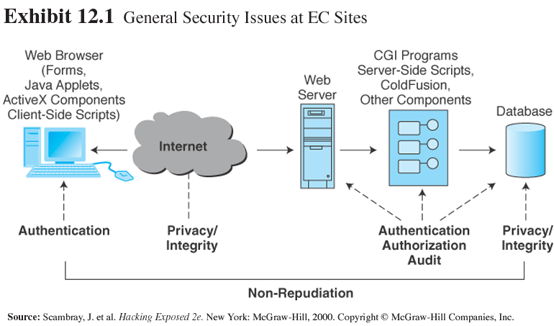
Types of Threats and Attacks (cont.)

Slide 35
Types of Threats and Attacks (cont.)
Social engineering: A type of nontechnical attack that uses social pressures to trick computer users into compromising computer networks to which those individuals have access

Slide 36
Types of Threats and Attacks (cont.)
Multiprong approach used to combat social engineering:
Education and training
Policies and procedures
Penetration testing

Slide 37
Types of Threats and Attacks (cont.)
Technical attack: An attack perpetrated using software and systems knowledge or expertise

Slide 38
Types of Threats and Attacks (cont.)
Common (security) vulnerabilities and exposures (CVEs): Publicly known computer security risks, which are collected, listed, and shared by a board of security-related organizations (cve.mitre.org)

Slide 39
Types of Threats and Attacks (cont.)
Denial-of-service (DoS) attack: An attack on a Web site in which an attacker uses specialized software to send a flood of data packets to the target computer with the aim of overloading its resources

Slide 40
Types of Threats and Attacks (cont.)
Distributed denial-of-service (DDoS) attack: A denial-of-service attack in which the attacker gains illegal administrative access to as many computers on the Internet as possible and uses these multiple computers to send a flood of data packets to the target computer

Slide 41
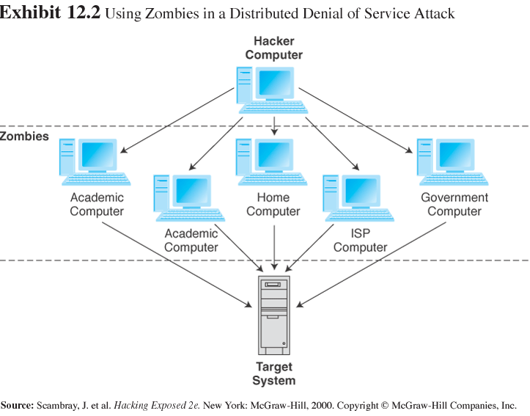
Types of Threats and Attacks (cont.)

Slide 42
Types of Threats and Attacks (cont.)
Malware: A generic term for malicious software
The severity of the viruses increased substantially, requiring much more time and money to recover
85% of survey respondents said that their organizations had been the victims of e-mail viruses in 2002

Slide 43
Types of Threats and Attacks (cont.)
Malicious code takes a variety of forms—both pure and hybrid
Virus: A piece of software code that inserts itself into a host, including the operating systems, to propagate; it requires that its host program be run to activate it

Slide 44
Types of Threats and Attacks (cont.)
Worm: A software program that runs independently, consuming the resources of its host in order to maintain itself and is capable of propagating a complete working version of itself onto another machine

Slide 45
Types of Threats and Attacks (cont.)
Macro virus or macro worm: A virus or worm that is executed when the application object that contains the macro is opened or a particular procedure is executed

Slide 46
Types of Threats and Attacks (cont.)
Trojan horse: A program that appears to have a useful function but that contains a hidden function that presents a security risk

Slide 47
Managing EC Security
Common mistakes in managing their security risks (McConnell 2002):
Undervalued information
Narrowly defined security boundaries
Reactive security management
Dated security management processes
Lack of communication about security responsibilities

Slide 48
Managing EC Security (cont.)
Security risk management: A systematic process for determining the likelihood of various security attacks and for identifying the actions needed to prevent or mitigate those attacks

Slide 49
Managing EC Security (cont.)
Phases of security risk management
Assessment
Planning
Implementation
Monitoring

Slide 50
Managing EC Security (cont.)
Phase 1: Assessment
Evaluate security risks by determining assets, vulnerabilities of their system, and potential threats to these vulnerabilities

Slide 51
Honeynet: A way to evaluate vulnerabilities of an organization by studying the types of attacks to which a site is subjected, using a network of systems called honeypots
Honeypots: Production systems (e.g., firewalls, routers, Web servers, database servers) designed to do real work but to be watched and studied as network intrusions occur

Slide 52
Managing EC Security (cont.)
Phase 2: Planning
Goal of this phase is to arrive at a set of policies defining which threats are tolerable and which are not
Policies also specify the general measures to be taken against those threats that are intolerable or high priority

Slide 53
Managing EC Security (cont.)
Phase 3: Implementation
Particular technologies are chosen to counter high-priority threats
First step is to select generic types of technology for each of the high priority threats

Slide 54
Managing EC Security (cont.)
Phase 4: Monitoring to determine
Which measures are successful
Which measures are unsuccessful and need modification
Whether there are any new types of threats
Whether there have been advances or changes in technology
Whether there are any new business assets that need to be secured

Slide 55
Managing EC Security (cont.)
Methods of securing EC
Authentication system
Access control mechanism
Passive tokens
Active tokens

Slide 56
Authentication
Authentication system: System that identifies the legitimate parties to a transaction, determines the actions they are allowed to perform, and limits their actions to only those that are necessary to initiate and complete the transaction

Slide 57
Authentication (cont.)
Access control mechanism: Mechanism that limits the actions that can be performed by an authenticated person or group

Slide 58
Authentication (cont.)
Passive tokens: Storage devices (e.g., magnetic strips) used in a two-factor authentication system that contain a secret code

Slide 59
Authentication (cont.)
Active tokens: Small, stand-alone electronic devices in a two factor authentication system that generate one-time passwords
Who goes there?

Slide 60
Biometric Controls
Biometric systems: Authentication systems that identify a person by measurement of a biological characteristic such as a fingerprint, iris (eye) pattern, facial features, or voice

Slide 61
Biometric Controls (cont.)
Physiological biometrics: Measurements derived directly from different parts of the body (e.g., fingerprints, iris, hand, facial characteristics)
Behavioral biometrics: Measurements derived from various actions and indirectly from various body parts (e.g., voice scans or keystroke monitoring)

Slide 62
Biometric Controls (cont.)
Fingerprint scanning: Measurement of the discontinuities of a person’s fingerprint, converted to a set of numbers that are stored as a template and used to authenticate identity
Iris scanning: Measurement of the unique spots in the iris (colored part of the eye), converted to a set of numbers that are stored as a template and used to authenticate identity

Slide 63
Biometric Controls (cont.)
Voice scanning: Measurement of the acoustical patterns in speech production, converted to a set of numbers that are stored as a template and used to authenticate identity

Slide 64
Biometric Controls (cont.)
Keystroke monitoring: Measurement of the pressure, speed, and rhythm with which a word is typed, converted to a set of numbers that are stored as a template and used to authenticate identity; this biometric is still under development

Slide 65
Encryption Methods
Public key infrastructure (PKI): A scheme for securing e-payments using public key encryption and various technical components

Slide 66
Encryption Methods (cont.)
Private and public key encryption
Encryption: The process of scrambling (encrypting) a message in such a way that it is difficult, expensive, or time-consuming for an unauthorized person to unscramble (decrypt) it

Slide 67
Encryption Methods (cont.)
Plaintext: An unencrypted message in human-readable form
Ciphertext: A plaintext message after it has been encrypted into a machine-readable form
Encryption algorithm: The mathematical formula used to encrypt the plaintext into the ciphertext, and vice versa

Slide 68
Encryption Methods (cont.)
Symmetric (private) key system
Key: The secret code used to encrypt and decrypt a message
Symmetric (private) key system: An encryption system that uses the same key to encrypt and decrypt the message

Slide 69
Encryption Methods (cont.)
Data Encryption Standard (DES): The standard symmetric encryption algorithm supported the NIST and used by U.S. government agencies until October 2, 2000
Rijndael: The new Advanced Encryption Standard used to secure U.S. government communications since October 2, 2000

Slide 70
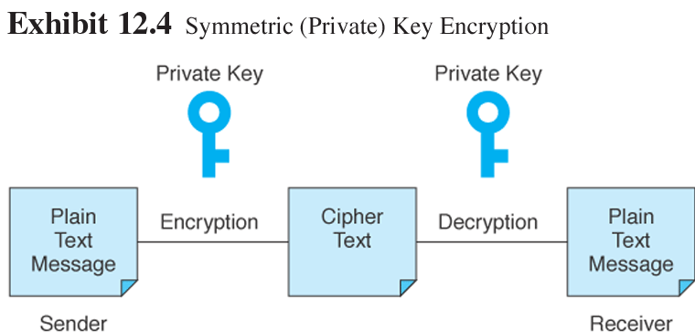
Encryption Methods (cont.)

Slide 71
Elements of PKI
Digital signature: An identifying code that can be used to authenticate the identity of the sender of a document
Portable
Cannot be easily repudiated or imitated, and can be time-stamped

Slide 72
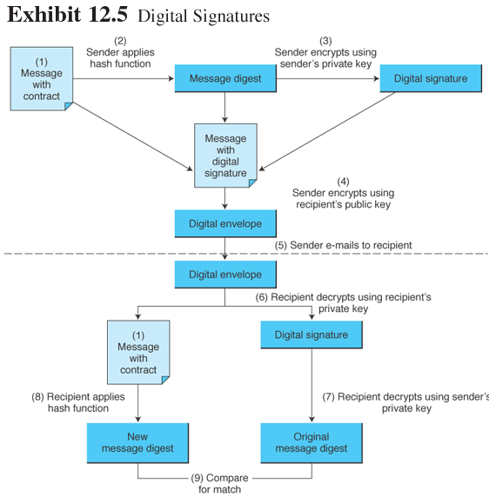
Elements of PKI (cont.)

Slide 73
Elements of PKI (cont.)
Digital signatures include:
Hash: A mathematical computation that is applied to a message, using a private key, to encrypt the message
Message digest: A summary of a message, converted into a string of digits, after the hash has been applied
Digital envelope: The combination of the encrypted original message and the digital signature, using the recipient’s public key

Slide 74
Elements of PKI (cont.)
Digital certificate: Verification that the holder of a public or private key is who they claim to be
Certificate authorities (CAs): Third parties that issue digital certificates

Slide 75
Security Protocols
Secure Socket Layer (SSL): Protocol that utilizes standard certificates for authentication and data encryption to ensure privacy or confidentiality
Transport Layer Security (TLS): As of 1996, another name for the SSL protocol

Slide 76
Security Protocols (cont.)
Secure Electronic Transaction (SET): A protocol designed to provide secure online credit card transactions for both consumers and merchants; developed jointly by Netscape, Visa, MasterCard, and others

Slide 77
Securing EC Networks
Technologies for organizational networks
Firewall: A network node consisting of both hardware and software that isolates a private network from a public network
Packet-filtering routers: Firewalls that filter data and requests moving from the public Internet to a private network based on the network addresses of the computer sending or receiving the request

Slide 78
Securing EC Networks (cont.)
Packet filters: Rules that can accept or reject incoming packets based on source and destination addresses and the other identifying information
Application-level proxy: A firewall that permits requests for Web pages to move from the public Internet to the private network

Slide 79
Securing EC Networks (cont.)
Bastion gateway: A special hardware server that utilizes application-level proxy software to limit the types of requests that can be passed to an organization’s internal networks from the public Internet
Proxies: Special software programs that run on the gateway server and pass repackaged packets from one network to the other

Slide 80
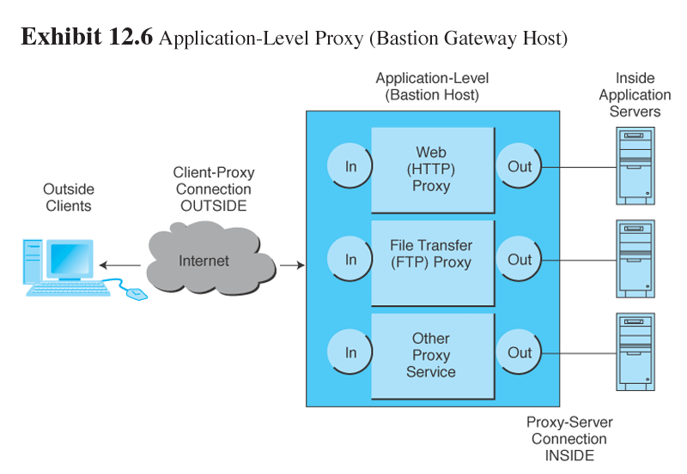
Securing EC Networks (cont.)

Slide 81
Securing EC Networks (cont.)
Personal firewalls:
Personal firewall: A network node designed to protect an individual user’s desktop system from the public network by monitoring all the traffic that passes through the computer’s network interface card

Slide 82
Securing EC Networks (cont.)
VPNs
Virtual private network (VPN): A network that uses the public Internet to carry information but remains private by using encryption to scramble the communications, authentication to ensure that information has not been tampered with, and access control to verify the identity of anyone using the network

Slide 83
Securing EC Networks (cont.)
Protocol tunneling: Method used to ensure confidentiality and integrity of data transmitted over the Internet, by encrypting data packets, sending them in packets across the Internet, and decrypting them at the destination address

Slide 84
Securing EC Networks (cont.)
Intrusion detection systems (IDSs): A special category of software that can monitor activity across a network or on a host computer, watch for suspicious activity, and take automated action based on what it sees

Slide 85
Securing EC Networks (cont.)
Network-based IDS uses rules to analyze suspicious activity at the perimeter of a network or at key locations in the network
Consists of a monitor—a software package that scans the software agents that reside on various host computers and feed information back to the monitor

Slide 86
Managerial Issues
Have we budgeted enough for security?
What are the business consequences of poor security?
Which e-commerce sites are vulnerable to attack?

Slide 87
Managerial Issues (cont.)
What is the key to establishing strong e-commerce security?
What steps should businesses follow inestablishing a security plan?
Should organizations be concerned with internal security threats?

Slide 88
Summary
Increase in computer attacks.
Security is everyone’s business.
Basic security issues.
Basic types of network security attacks.
Managing EC security.
Securing EC communications.
Technologies for securing networks

Slide 89

Selesai

